Slide 1
Unit 1 – Programming Concepts
Instructor: Brent Presley

Slide 2
Overview
Set up mac profile & transfer VM’s
Programming philosophy
Problem solving steps
Basis of Programming
Control Structures
Thinking like a programmer
Breaking a problem into parts
Testing a solution

Slide 3
Set up profile on the mac
Instructor and assistant will log you in as an administrator
Then create your own profile
  Use a password you can remember easily
Set up the mouse in the ‘traditional’ manner if you wish

Slide 4
Transfer Virtual Machine
Transfer virtual machine from the admin account to your account. This will take a while to complete
  Save it on your desktop
  May wish to save it to a flash drive
  Always shut down VM at end of class

Slide 5
Programming philosophy
Programming can be taught
Logic is more difficult
  experience is important
Characteristics of a good programmer
  Love solving puzzles
  They are patient – dealing with people who are non-programmers
  They over-analyze – reduce problems to smallest components
  They are intellectually curious
  They’re lazy…in a good way – make sure you don’t do things twice
  They’re often pessimistic – anticipate all possible contingencies
  They’re always learning new things – the field changes constantly

Slide 6
Problem solving steps
Identify alternate ways to solve the problem & select the best way
  You are given a project proposal or a user’s idea
  Develop a user story
    from Amazon.com
      “As an Amazon prime customer I want to be able to order without having to re-enter my delivery information so that my order can be completed quickly.”
Determine: what does the user want? Listen.

Slide 7
Problem solving steps
Identify and understand the problem
  Is a computer solution the best answer?
Choose the best solution
  List the instructions that allow you to solve the problem
    The computer will only do what you tell it to do.
    Use the programming language to develop a set of instructions that are: clear, concise, and consistent. MAINTAINABLE
Evaluate and test the solution.
    What is complete testing?
    Example of poor testing. http://www.devtopics.com/20-famous-software-disasters/

Slide 8
Problem solving steps
  Define the end goal
  Provide instructions for your program
    Include all contingencies
  Break programs into small parts
  Consider: what are the automatic processes
    Things you did not explicitly tell them to do.
    Understand these automatic processes
      Garbage disposal
      Allocating memory for just one more item

Slide 9
Basis of programming
  Define the end goal for the program
  Provide instructions so the program can handle all circumstances it encounters
  Break the program into small parts
  Textbook: read page 24-27

Slide 10
Control structures
  Sequential
    Complete instructions one after the other
      Add 10 scores together, then divide by 10
      Take every customer and add them to a mailing list
      Take every poker chip and bet it on this hand

Slide 11
Control structures
  Decision/Selection logic
    Choose an option then take the correct steps
      Get annual salary
      Get years of service
      If years of service is >1 then
        Calculate raise
        Display raise amount
      Else
        Display notice of annual review
      End if

Slide 12
Control structures
  Repetition Logic
    Repeat a group of statements over and over.
      Repeat for each employee
        Get annual salary
        Get years of service
        If years of service >1
          Calculate raise
          Display raise amount
        Else
          Display notice of annual review
        End if
      End repeat

Slide 13
Think like a programmer
Computers are stupid
  They only do what they are told
  Computers are not intelligent, but are fast & efficient
  If it does not work, it’s not the computer’s fault
Break down what you do into tiny steps
Combine the control structures to solve the problem

Slide 14
Think like a programmer
Intro to thinking like a computer
  Code.org has good examples
    The site looks to increase interest in programming for new students
    Set up with games to make the activities fun.
  https://code.org/
    Go to the “Hour of Code” area
      Lightbot
        Lightbot has a limited set of commands that increases as you progress. Note how stupid he can be..he only does what he is told to do.

Slide 15
Break programs into parts
With larger problems, you have to break them down into parts to manage it better
  Programming languages are built this way

Slide 16
Break programs into parts
After determining the parts of a program, you may need to break down further
  Continue to break it down until it’s manageable
  Keep breaking it down until the problem is in small, bite-sized pieces.
    handle each potential problem within the small piece you’re working on
    Example: school registration system
  A whole team may work on a project, just different parts
    Do easier parts first.
    May not solve parts in order

Slide 17
Break programs into parts
Lightbot specifics
  You can test your solutions and see immediate results
  Lightbot puzzles have one goal, where most real programs have many goals
    Testing can become complex
    Easy to make mistakes in testing
  Test thoroughly
    Make sure your program handles all situations
    Consider the size of some programs, and what must be done to test it… Windows
  There is more than one way to solve the problem
  Assignment: Complete Lightbot basics, Procedures, Loops

Slide 18
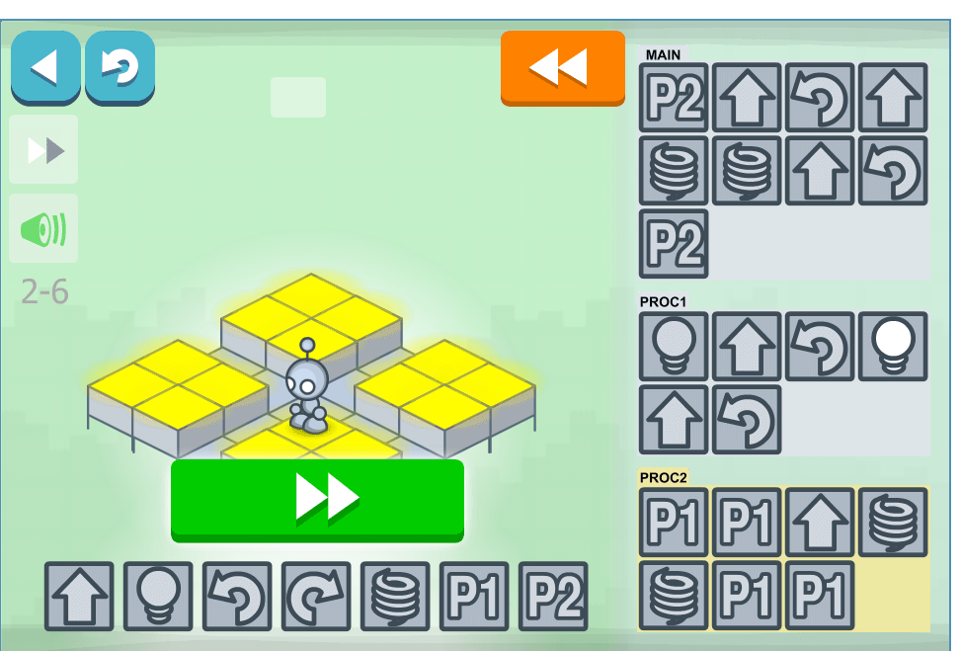
Break programs into parts
Lightbot 2
  (last one)

Slide 19
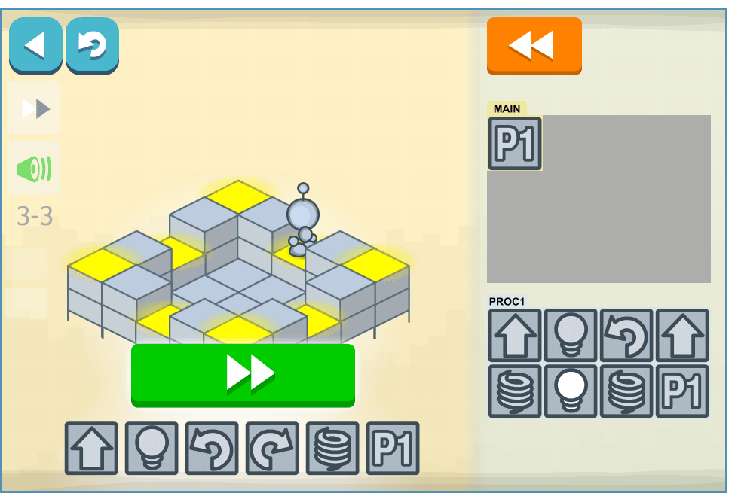
Break programs into parts
Lightbot 3
    3rd one

Slide 20
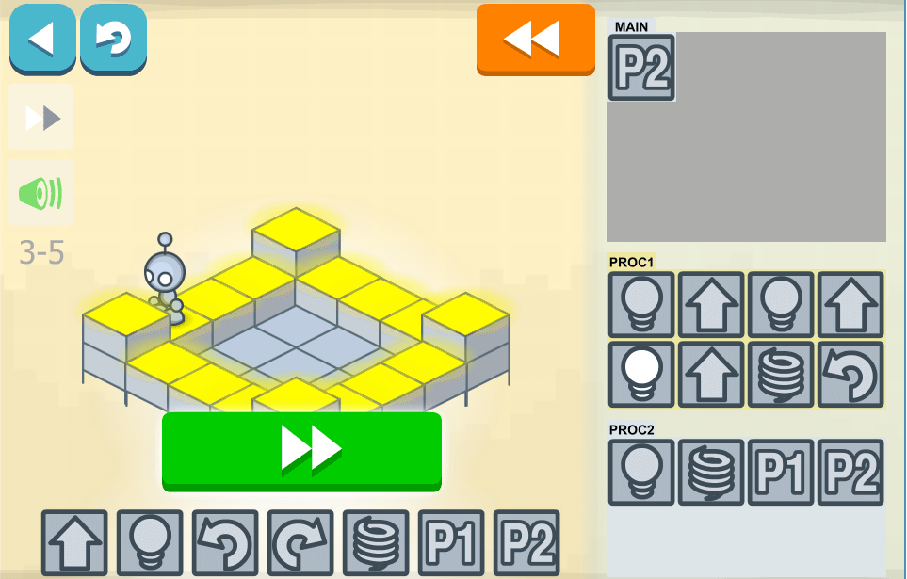
Break programs into parts
Lightbot 3
  4th

Slide 21
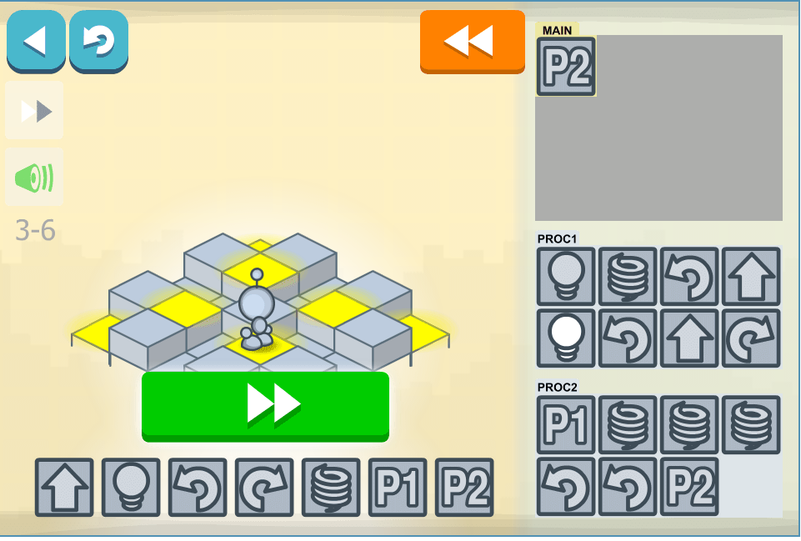
Break programs into parts
Lightbot 3
  5th

Slide 22
Programming practice
Code.org additional item
  You will be required to do “tutorials for beginners” from the site also. This is an Angry Birds maze

Slide 23
Lessons from Lightbox
Basics
Part 1
Clear program goals required
Need to fully understand what each command does
Part 2
Situational awareness is important (which way facing)
Part 3
Some commands have side effects (jump also moves forward) (VS Form Load)
Some commands do different things in different circumstances (jump up/down)
Programs can be tested in parts (get to 2nd level, get to 3rd level, finish)
Avoid unnecessary commands (extra steps)
Part 4
Often many acceptable solutions to same problem.
Part 5
Part 6
Break into parts
Part 7
In the real world there is no fixed size box that tells the maximum number of commands required.

Slide 24
Lessons from Lightbox
Procedures
Part 1
Positive reinforcement helps
Reusable code can be stored in procedures/methods and used as many times as necessary
VS: many procedures (sorting, searching) have been incorporated into the language
Test procedure separately
Part 2
Learn to recognize repeatable patterns
But avoid excess commands
Part 3
In the real world there are no restrictions on the number of commands in a method
Part 4
(Forget the 2nd turn) Programming is often trial and error especially when you’re learning
Part 5
In real world can create as many methods as you need.
Many shops have large libraries of methods. Often so large people don’t realize what’s in them.
Methods can invoke other methods
(only code P2) Test. Methods must be invoked or called to execute
Note main can call P1 and P2
Part 6
Numerous solutions

Slide 25
Lessons from Lightbox
Loops
Part 1
Procedures that call themselves is called recursion.
In the real world this is an advanced programming technique.
Easier here because LightBot automatically ends when the last square is lit
This is NOT the way loops work in real programming
(Good logic exercise though)
Part 2
Part 3
Part 4
Part 5
Note P2 cannot be step, light, P2 (endless)
Note P1 if it had enough boxes could handle everything

Slide 26
Lessons from Angry Birds
Angry Birds Maze
Part 1
Part 2
Part 3
Still need situational awareness
Part 4
Sometimes you learn by purposely creating errors (blow up)
Part 5
More situational awareness.
You have to be able to visualize the program’s state
I like how the program penalizes you for adding extra commands (too many steps wouldn’t cause an issue in LightBot)
Part 6
This simulates program loops much more accurately
Part 7
Part 8
Using the fewest number of blocks is not always the best solution
In this class if you can come up with logic that works, code it! If I know a better, more elegant solution, I’ll guide to you to.
Experience will help you use more elegant solutions, but even experienced programmers often implement the first solution that works (who has time to think of all other possibilities).
In Show Code, note how indentation shows ownership
In Show Code, this is an example of a combination of sequential and repetition blocks combined in different ways

Slide 27
Lessons from Angry Birds
Part 9
Good logic exercise, but not real world
Note the last repetition of the loop has an extra step (right) but program automatically senses the end (not real world)
Show code: again note indentation
Part 10
In real programming, the end of the loop is defined using a relational condition (location of bird = location of pig) (see Show Code)
Note every solution does not require every command in the command set
Part 11
Every time the body of the loop completes, the program automatically goes to the top, checks the condition and repeats if the condition is false. If the condition is true, the statement after body of the loop is executed.
Part 12
Why only 5 blocks? Because that’s the most elegant solution.
Show code: Note the loop continues while notFinished (sound). Same as birds, but defined differently underneath

Slide 28
Lessons from Angry Birds
Part 13
Part 14
Finally, the decision construct
Show code: note indentation
Part 15
Part 16
Note the zombie’s radar
Part 17
Not much different, but like the video said, practice helps you recognize when to use elegant patterns.
Part 18
These types of decisions are very common (IF-Then-Else)
Show code indentation
Many loops like these (while notFinished) have been replaced by user control. Program keeps running until the user closes it.
Think about what must be inside moveForward (animation), turnLeft, notFinished (sound)
Note their resuability
Part 19
Part 20
This is called a nested IF.
Show Code
I would be nice if real programming could show you the block layout you need

